Slide 1
Modeling the Pandemic: When Science Meets Politics
Things you will learn in this course
How epidemiologists model the spread of infectious diseases without any complicated mathematics
How they use those models to make projections and estimate the effects of government interventions
The limits of those methods and how confident you should be in their conclusions
The way in which those conclusions can or cannot be used to inform policy and how this interacts with philosophical considerations

Slide 2
Modeling the Pandemic: When Science Meets Politics
Evaluation
Attendance and participation in class (10%)
Midterm exam: a few questions on concepts we have studied in class (45%)
Final term paper: a short take-home paper on 1 of 2 topics related to material discussed in class (45%)

Slide 3
Modeling the Pandemic: When Science Meets Politics
A note about the subtitle of the course
"Politics" here (mostly) doesn't mean electoral politics
Not a course about how Macron, Trump, Biden or whoever used scientific results to further their political agenda
I’m talking about politics very broadly construed and it can refer to vague ideological preferences, academic politics, etc.

Slide 4
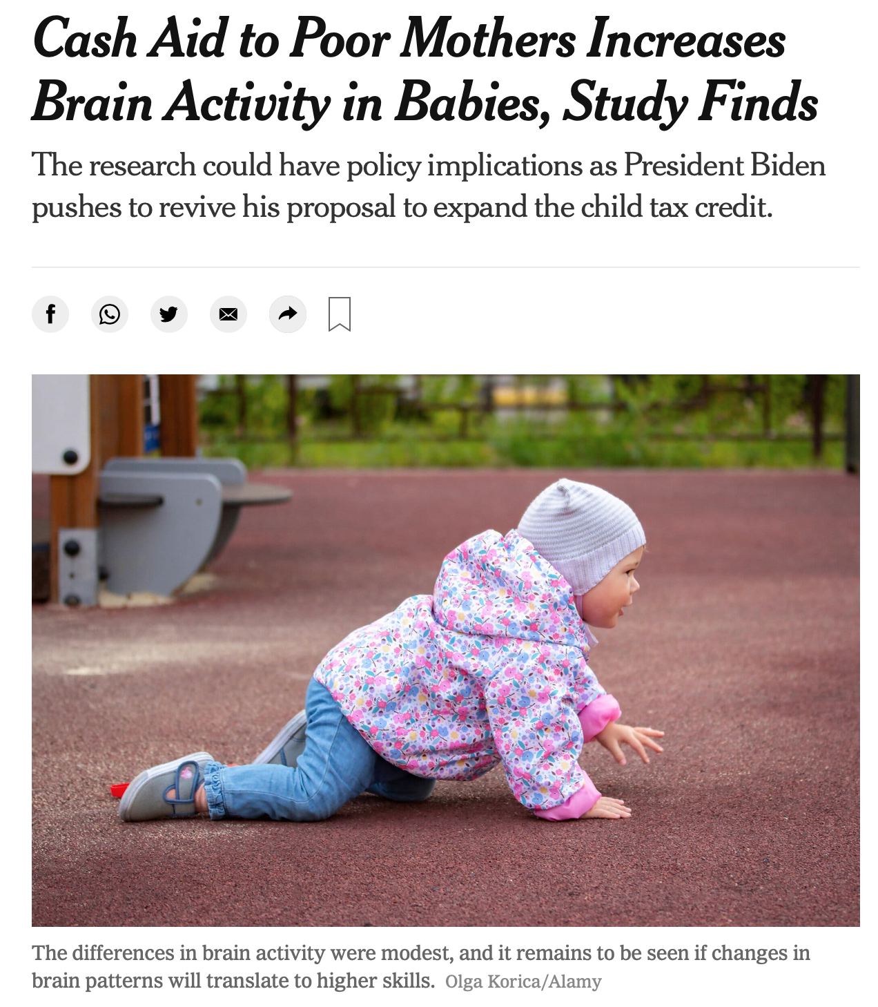
Modeling the Pandemic: When Science Meets Politics
Example

Slide 5
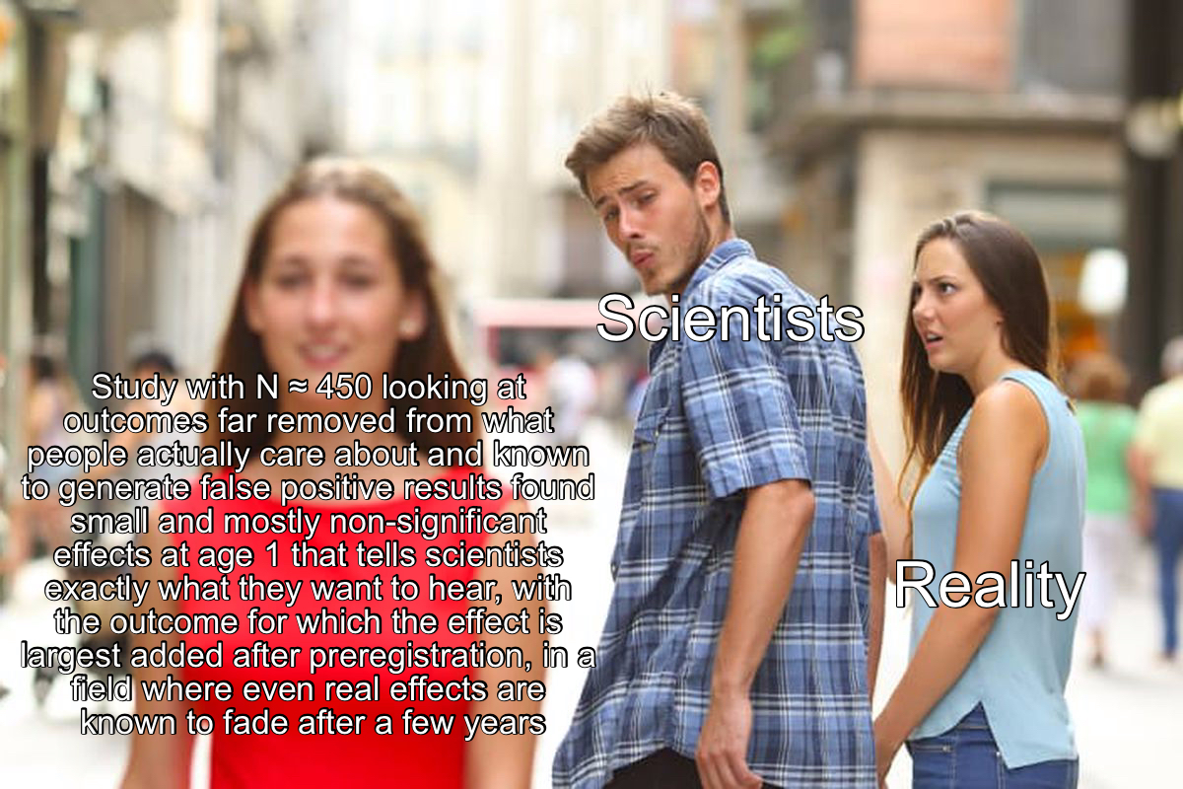
Modeling the Pandemic: When Science Meets Politics

Slide 6
Modeling the Pandemic: When Science Meets Politics
Outline
Virology for dummies: What you need to know about viruses to model epidemics
R and all that: Some basic concepts of the epidemiology of infectious diseases
Introduction to scientific modeling
The SIR model and its variants – Part 1
The SIR model and its variants – Part 2
The SIR model and its variants – Part 3
Estimating the effects of non-pharmaceutical interventions – Part 1
Estimating the effects of non-pharmaceutical interventions – Part 2
How pandemics end: The transition toward endemicity
Utilitarianism and its discontent
Reasoning under uncertainty and the ethics of restrictions to mitigate the COVID-19 pandemic – Part 1
Reasoning under uncertainty and the ethics of restrictions to mitigate the COVID-19 pandemic – Part 2

Slide 7
Modeling the Pandemic - Virology for dummies: What you need to know about viruses to model epidemics
What is a virus ?
"An infectious, obligate intracellular parasite comprising genetic material (DNA or RNA), often surrounded by a protein coat, sometimes a membrane." (Vincent Racaniello)

Slide 8
Modeling the Pandemic - Virology for dummies: What you need to know about viruses to model epidemics
Viruses are typically very small: you can fit 500 million of them on the head of a pin
They are very old: they probably appeared billions of years ago and may actually pre-date cells
They are everywhere: viruses outnumber cellular life by at least 10 to 1 (there are more of them in a liter of coastal seawater than people on earth)
Not all of them are bad for us and some of our genetic code even originates in viruses (placental mammals were able to evolve a placenta because of a retrovirus infections that occurred in our ancestors millions of years ago)

Slide 9
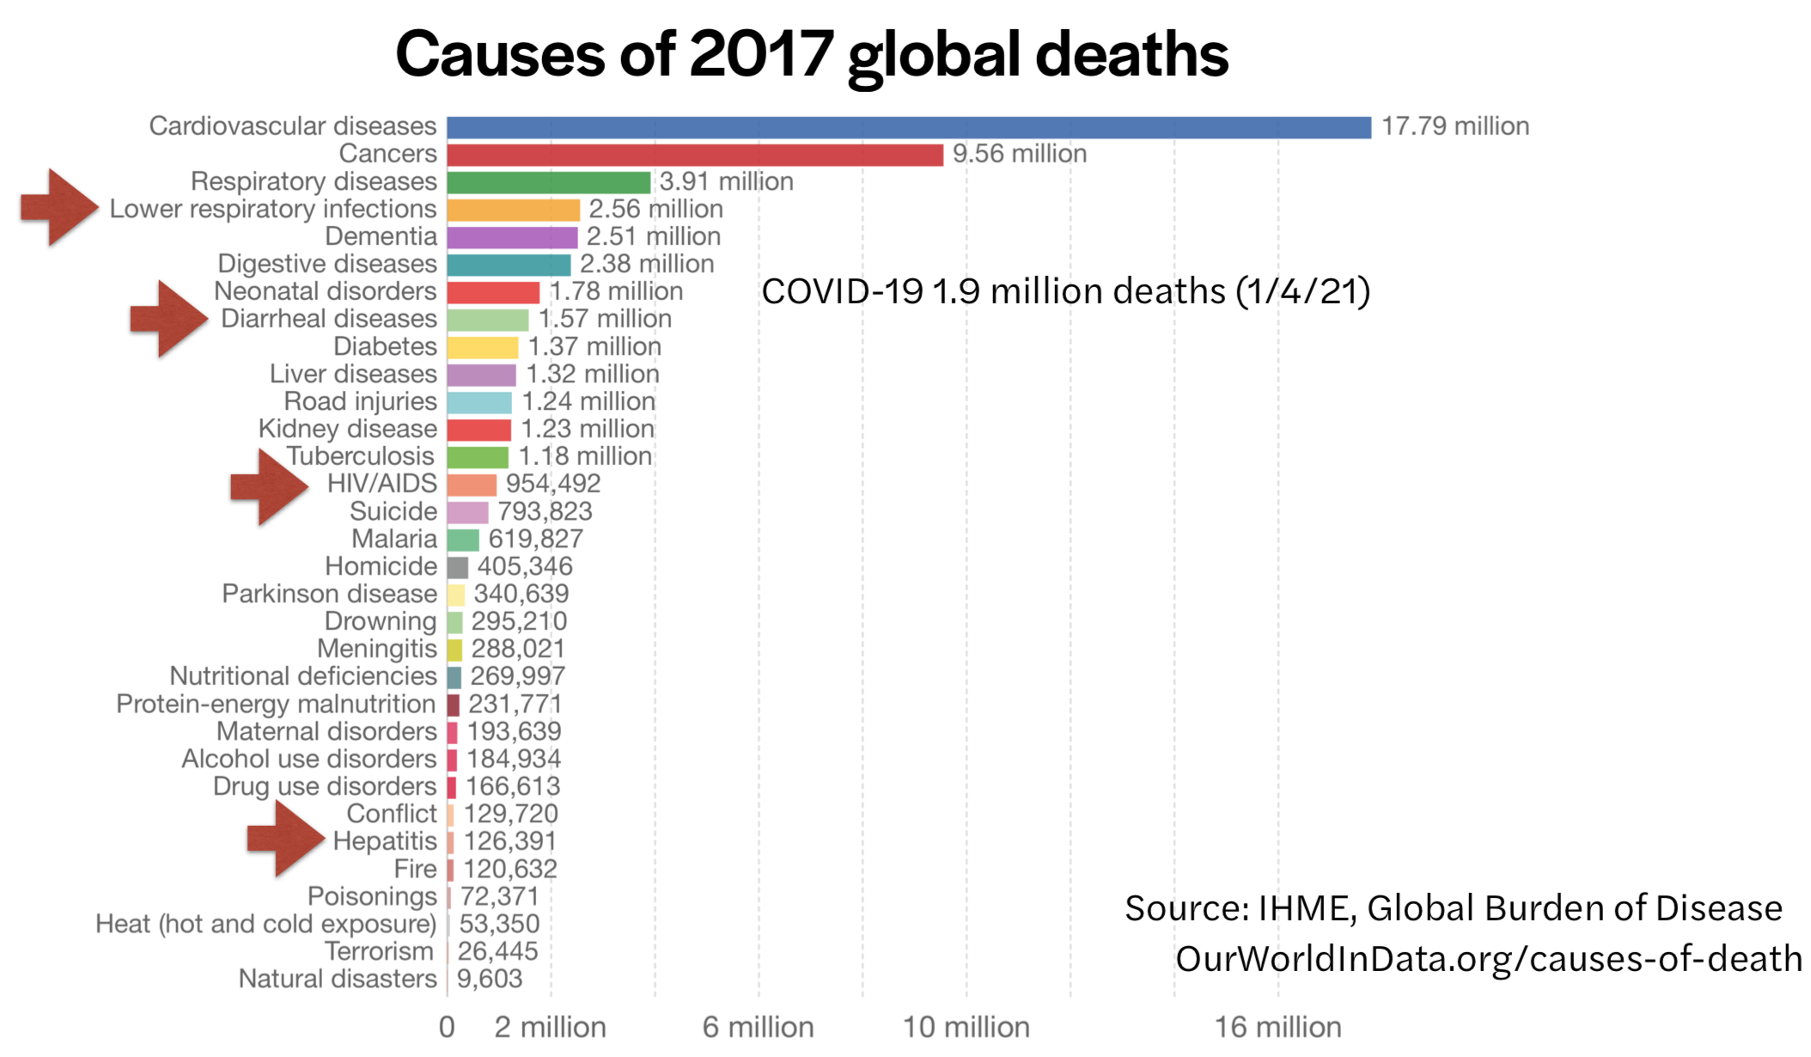
Modeling the Pandemic - Virology for dummies: What you need to know about viruses to model epidemics
Some of them are bad for us though

Slide 10
Modeling the Pandemic - Virology for dummies: What you need to know about viruses to model epidemics
SARS-CoV-2 is a positive-sense, single-stranded, non-segmented RNA virus belonging to the coronaviridae family
It has a genome of ~30,000 base pairs (human genome has 3 billions)
SARS-CoV-2 ≠ COVID-19
Likely evolved in bats, but the details are still murky
Mutates slowly compared to most other RNA viruses

Slide 11
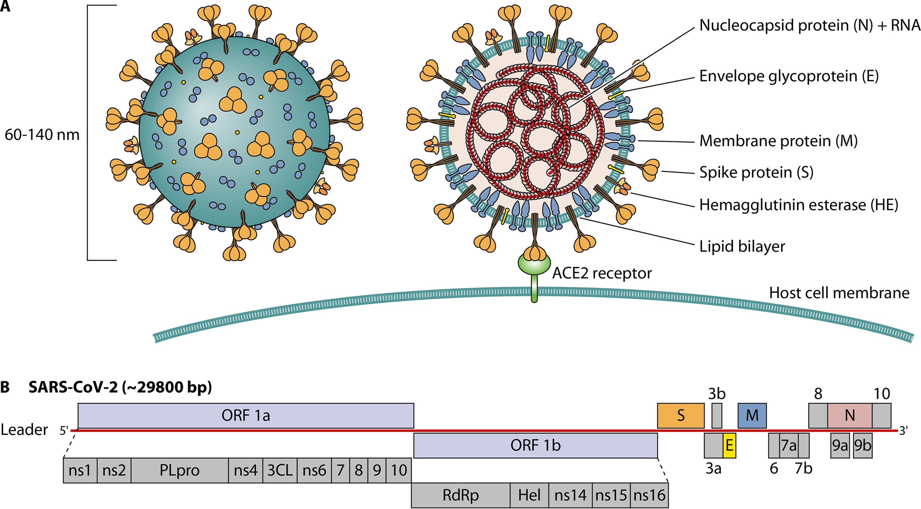
Modeling the Pandemic - Virology for dummies: What you need to know about viruses to model epidemics
The structure of SARS-CoV-2 and its genome

Slide 12
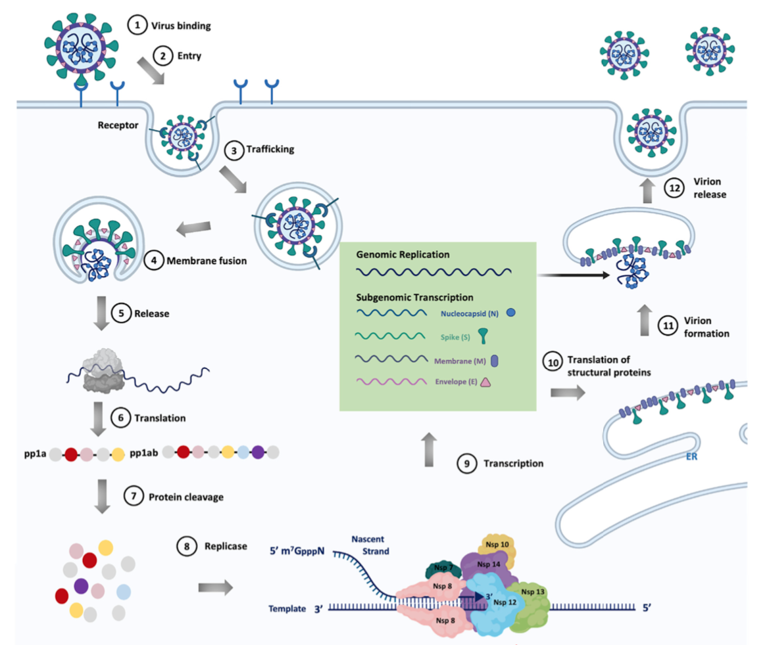
Modeling the Pandemic - Virology for dummies: What you need to know about viruses to model epidemics
The infectious cycle

Slide 13
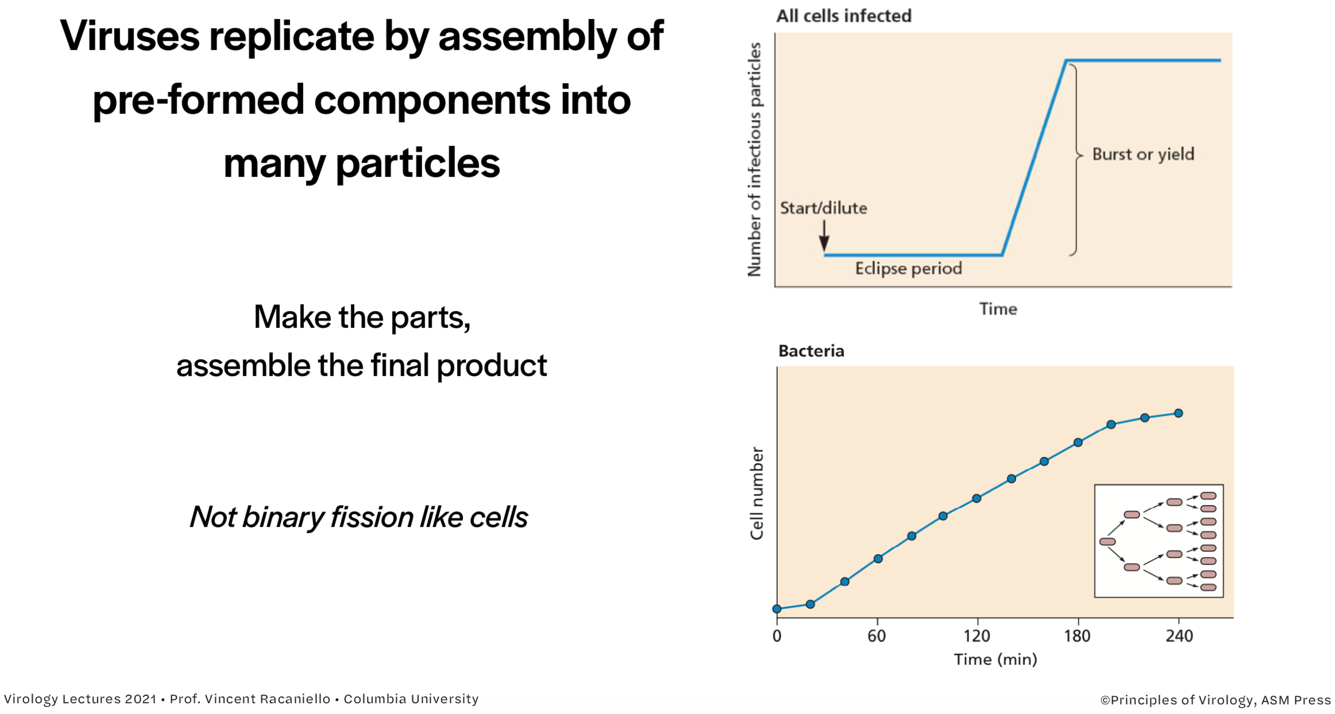
Modeling the Pandemic - Virology for dummies: What you need to know about viruses to model epidemics

Slide 14
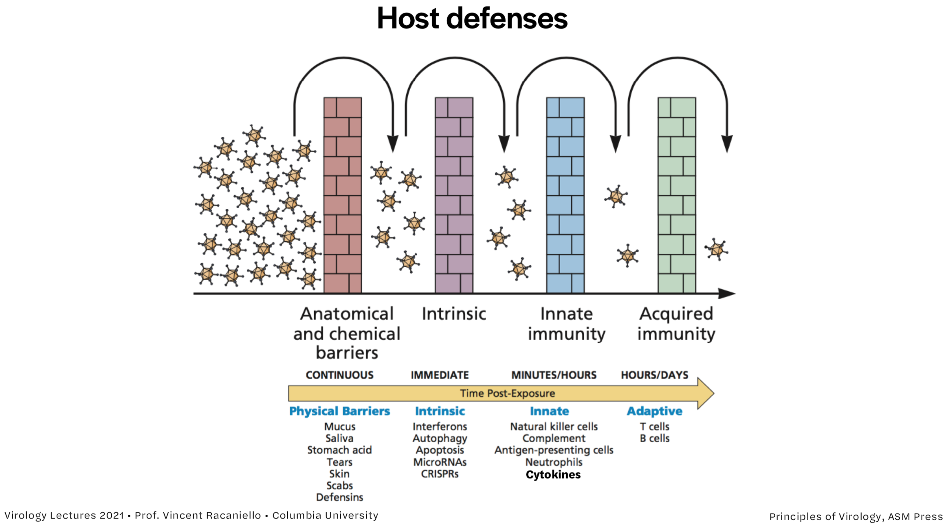
Modeling the Pandemic - Virology for dummies: What you need to know about viruses to model epidemics

Slide 15
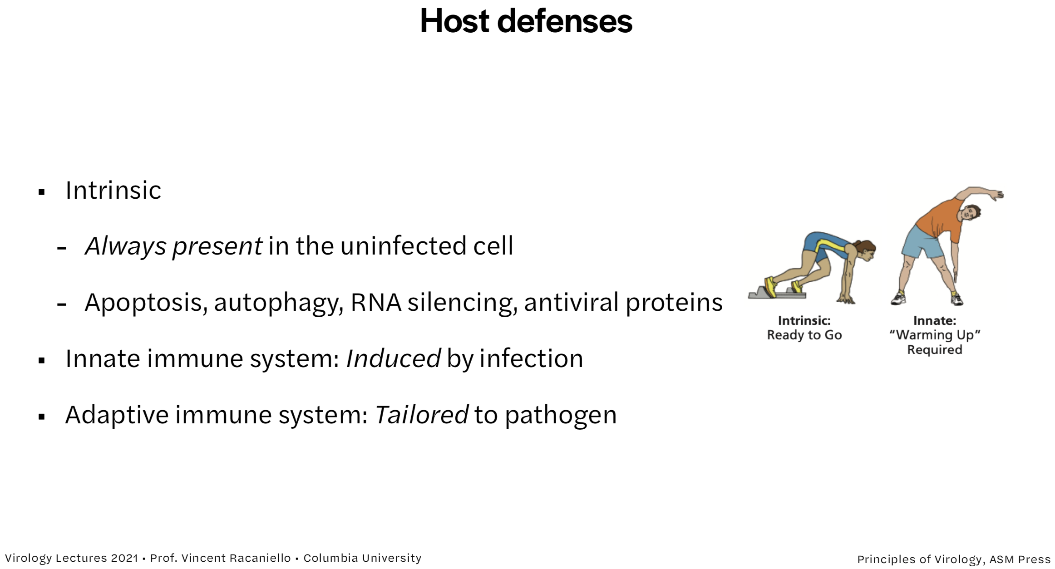
Modeling the Pandemic - Virology for dummies: What you need to know about viruses to model epidemics

Slide 16
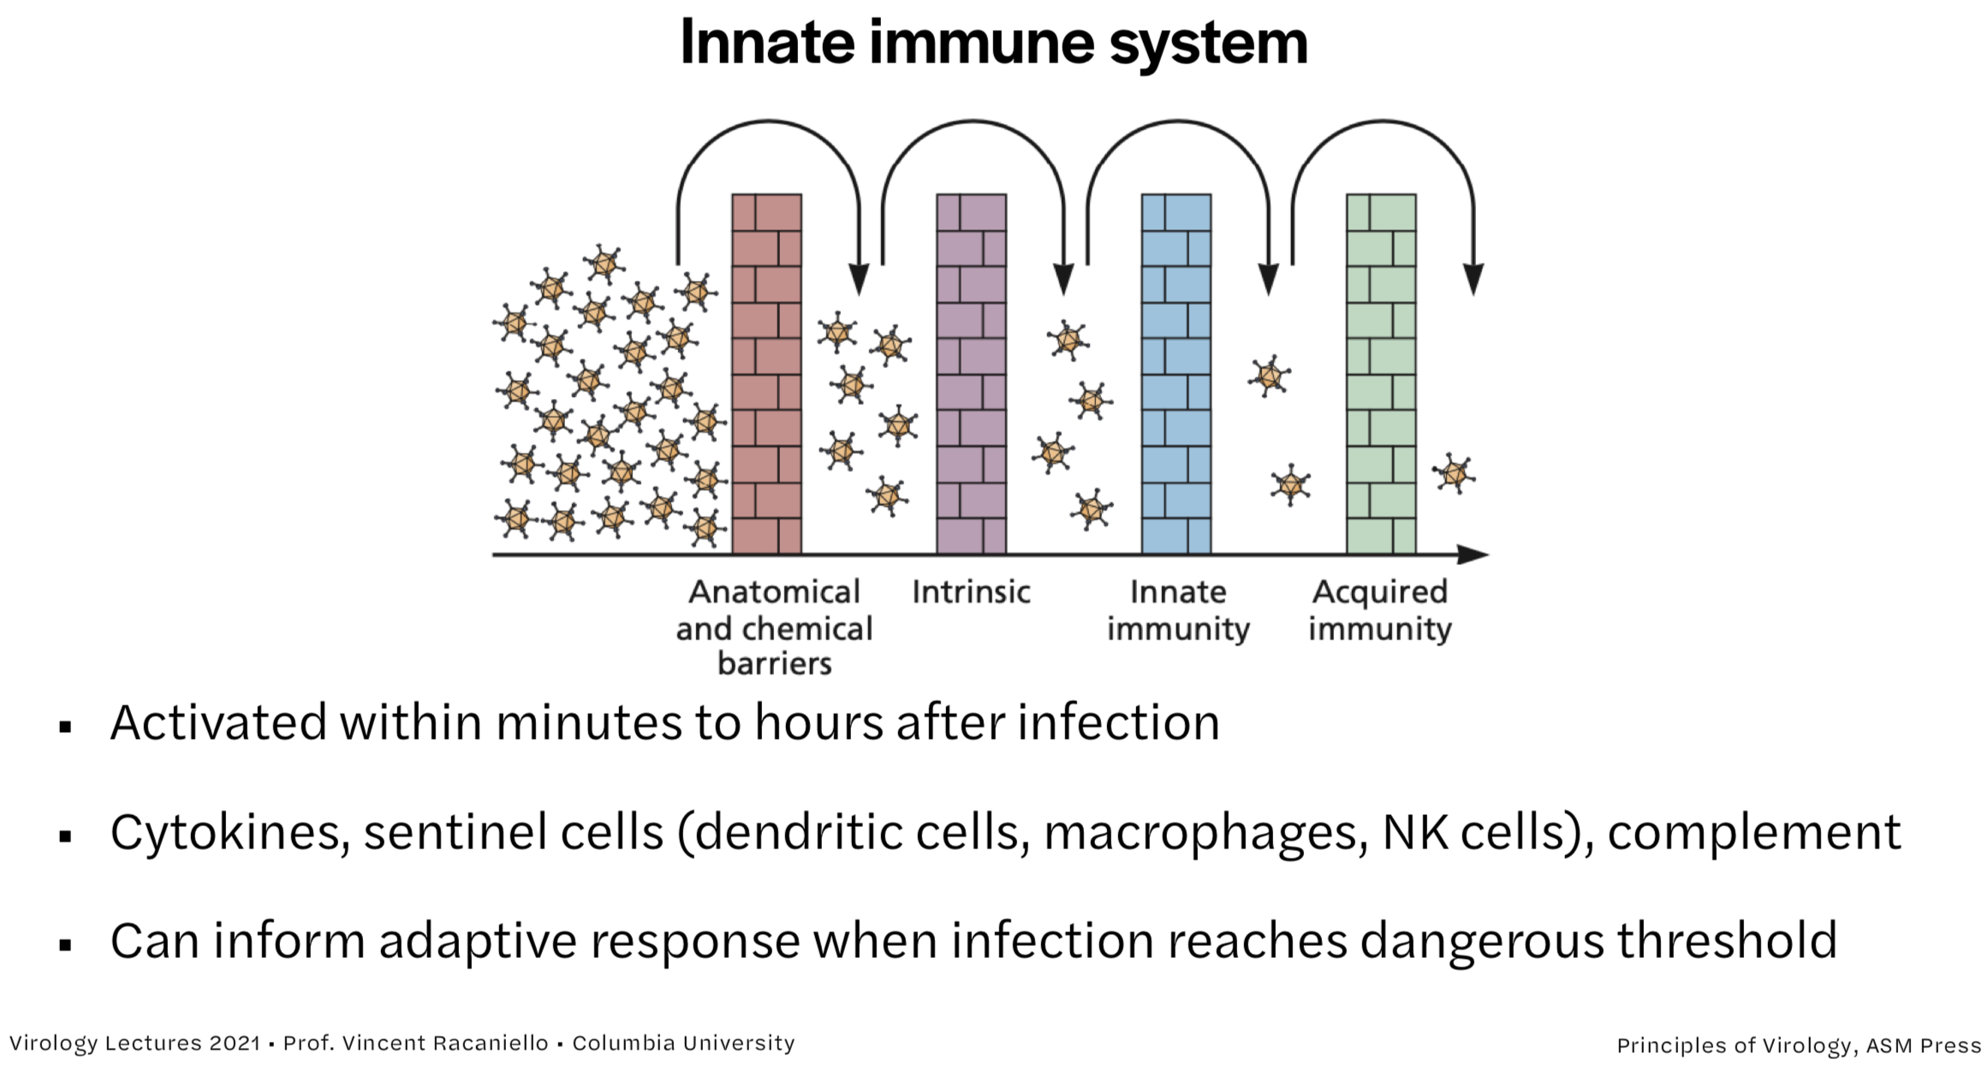
Modeling the Pandemic - Virology for dummies: What you need to know about viruses to model epidemics

Slide 17
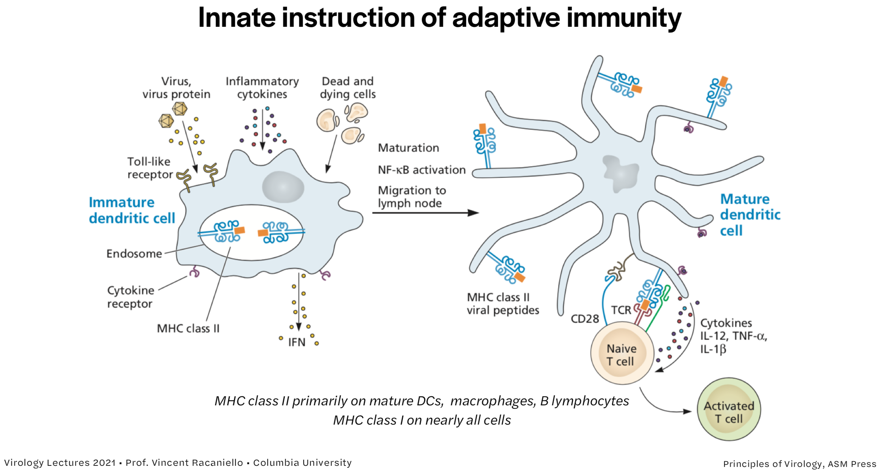
Modeling the Pandemic - Virology for dummies: What you need to know about viruses to model epidemics

Slide 18
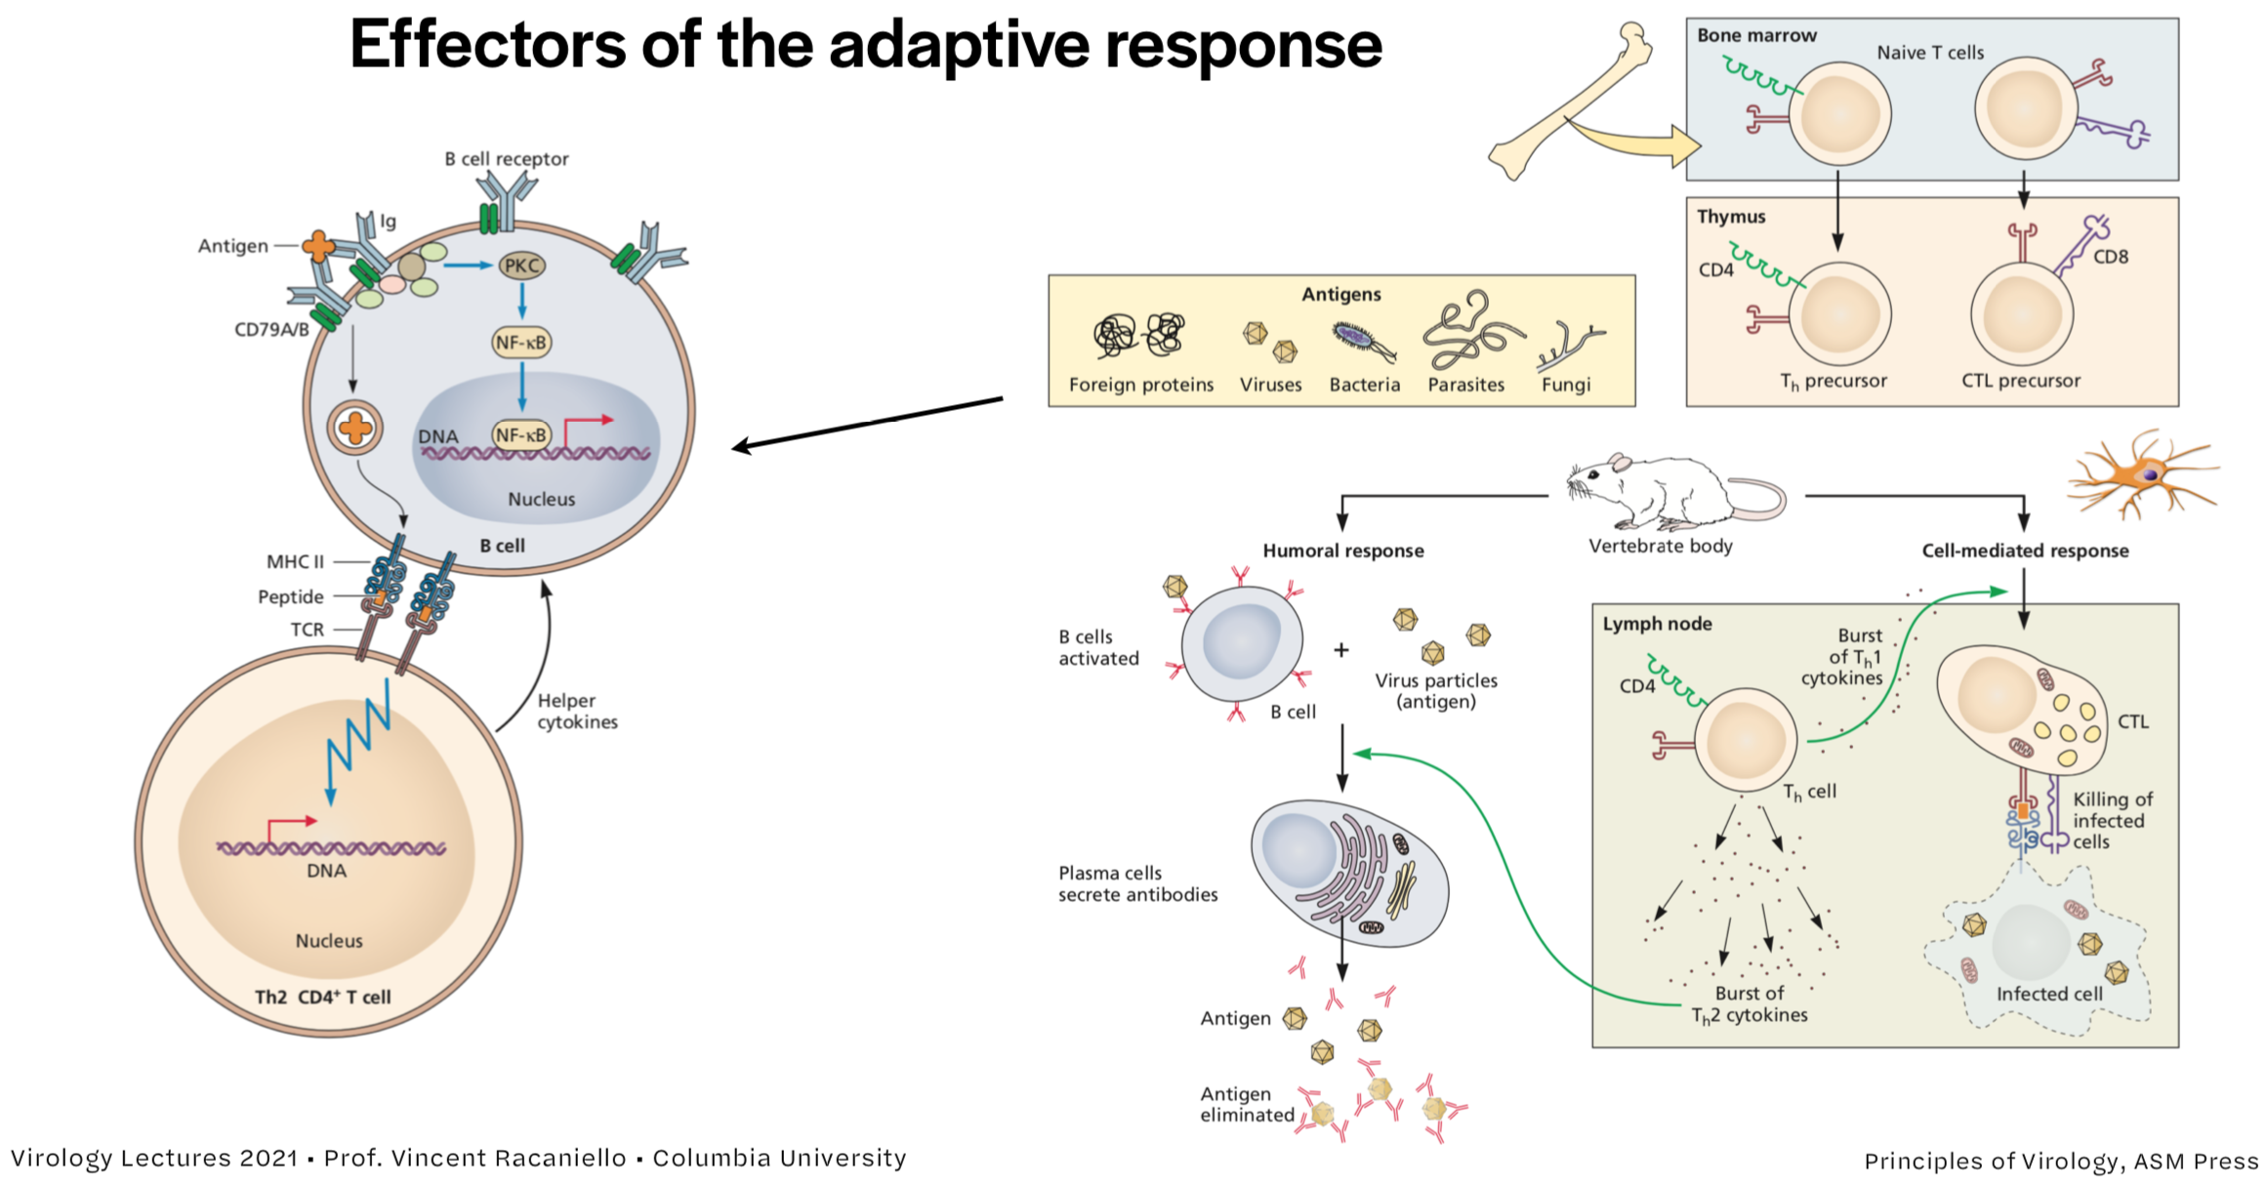
Modeling the Pandemic - Virology for dummies: What you need to know about viruses to model epidemics

Slide 19
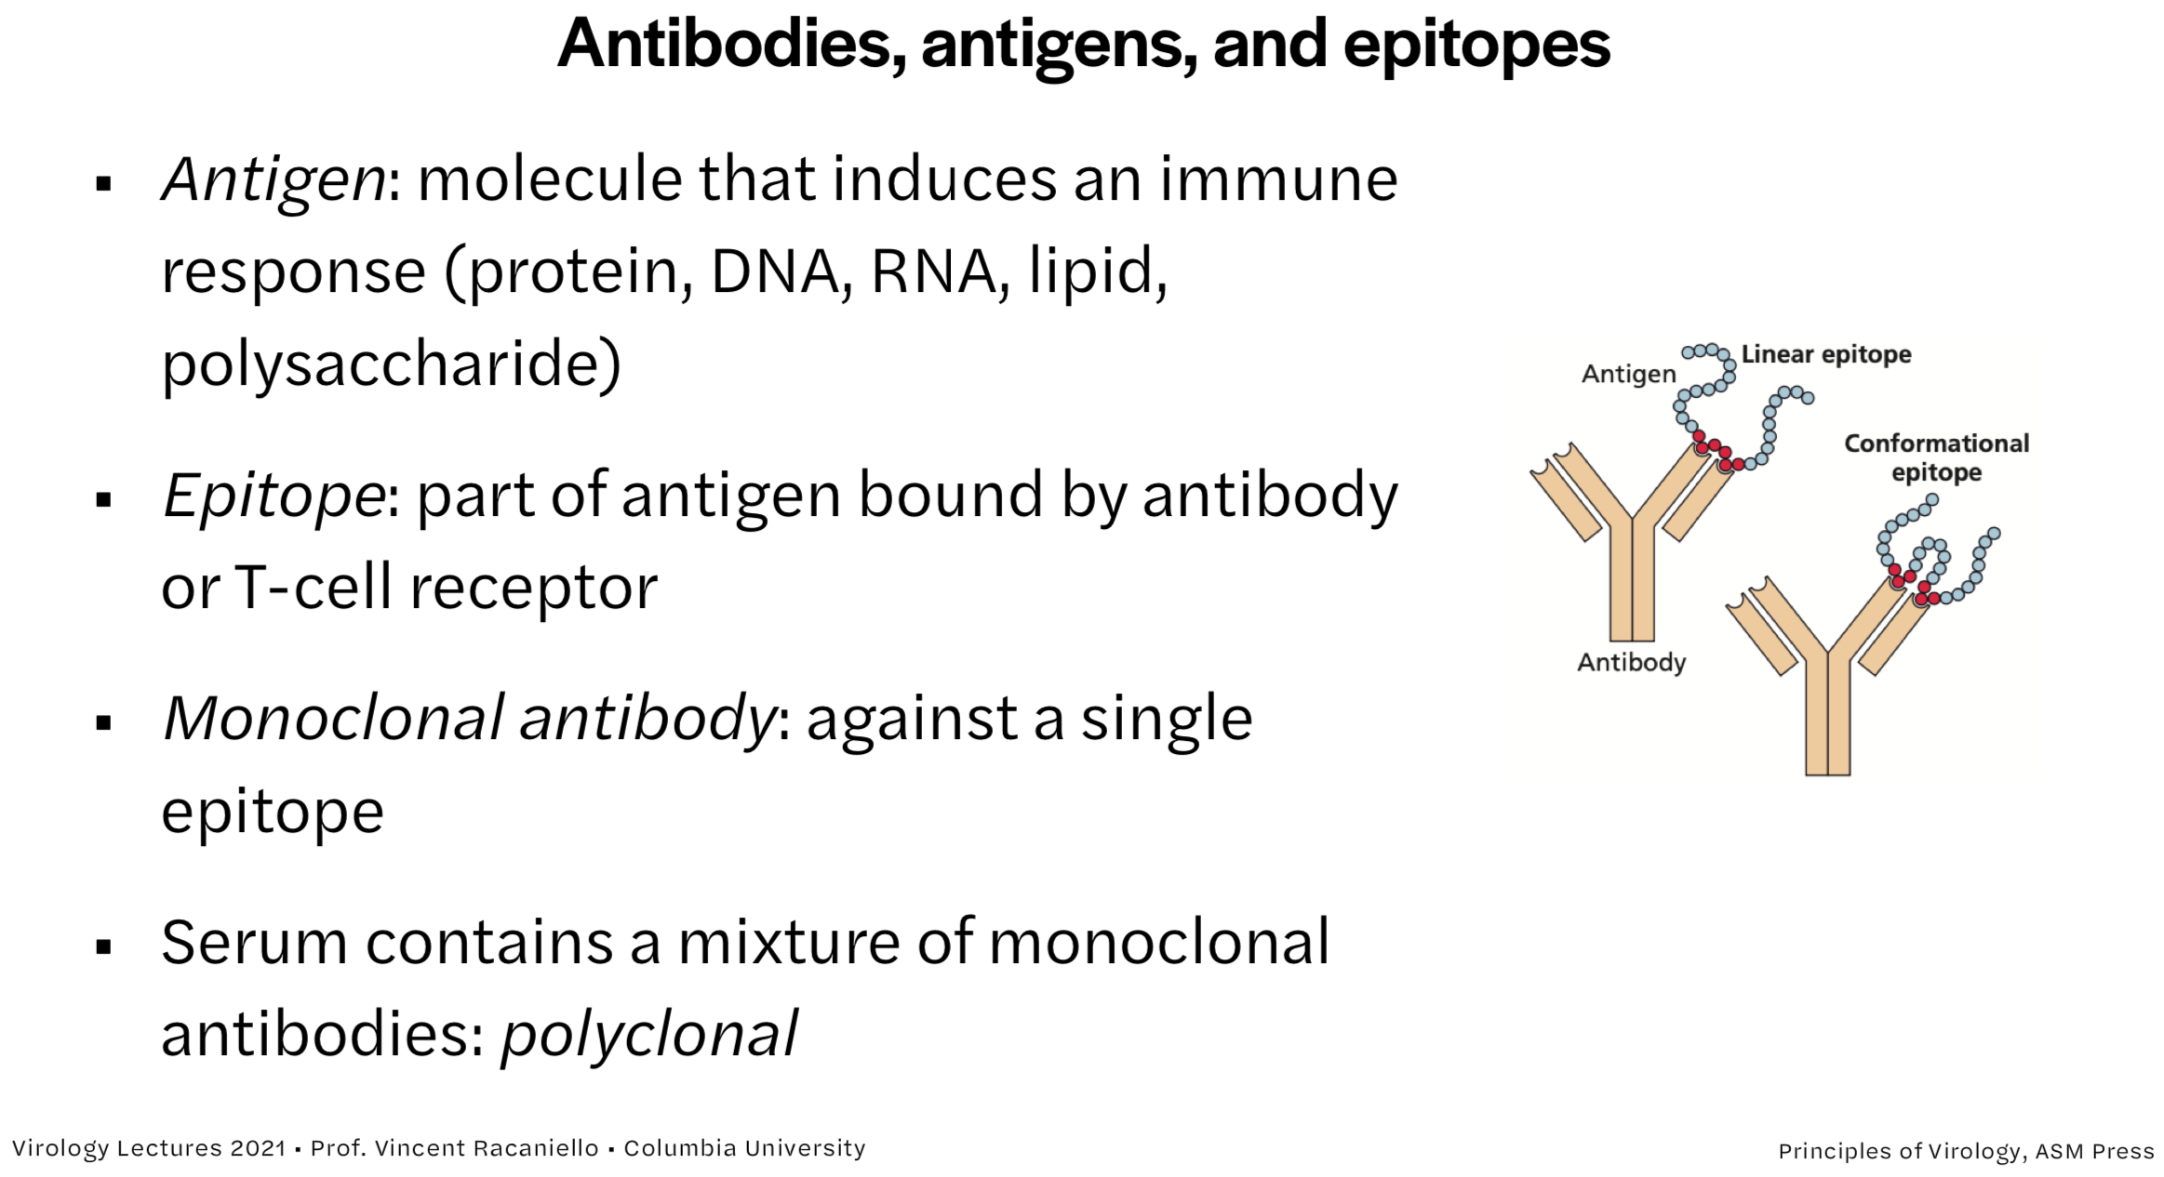
Modeling the Pandemic - Virology for dummies: What you need to know about viruses to model epidemics

Slide 20
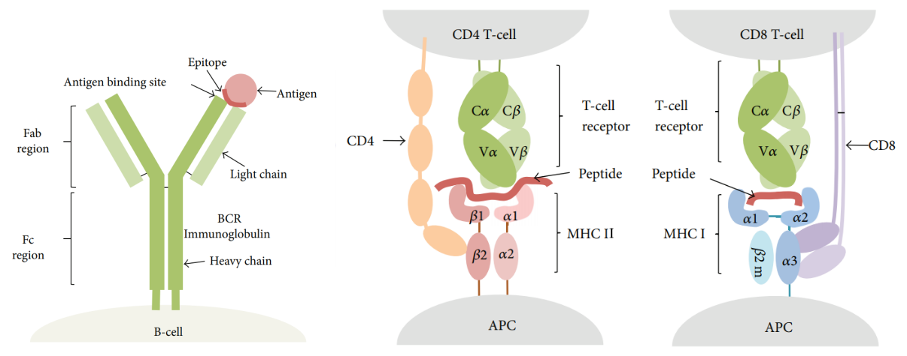
Modeling the Pandemic - Virology for dummies: What you need to know about viruses to model epidemics

Slide 21
Assessing the age specificity of infection fatality rates for COVID‐19: systematic review, meta‐analysis, and public policy implications
Vaccines work by inducing adaptive immunity ahead of infection
Viruses evolve various countermeasures to host defenses
In particular, they undergo antigenic drift, which can prevent antibodies from binding them or at least make them do so less effectively
This can make reinfection likely after a while, but it doesn’t mean that you are not still protected against severe disease

Slide 22
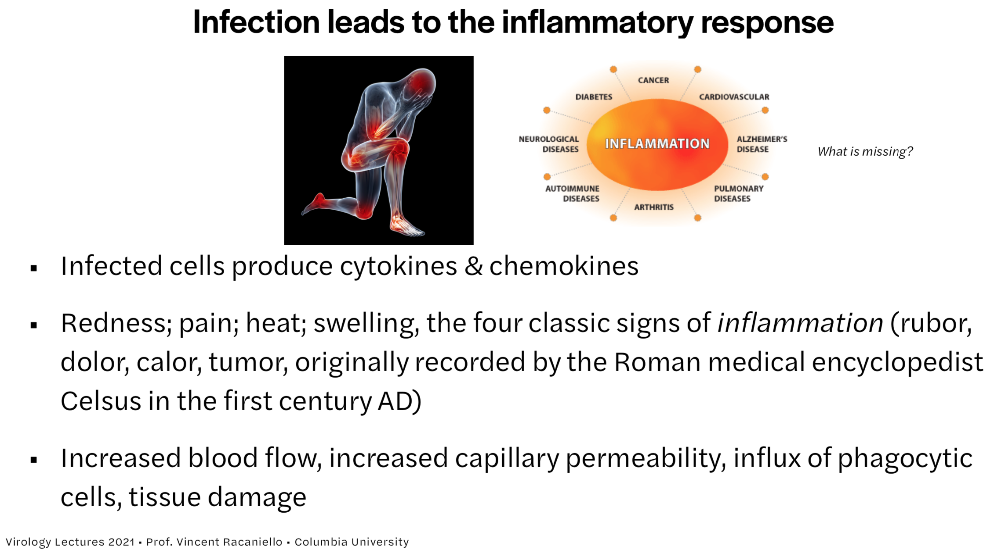
Modeling the Pandemic - Virology for dummies: What you need to know about viruses to model epidemics

Slide 23
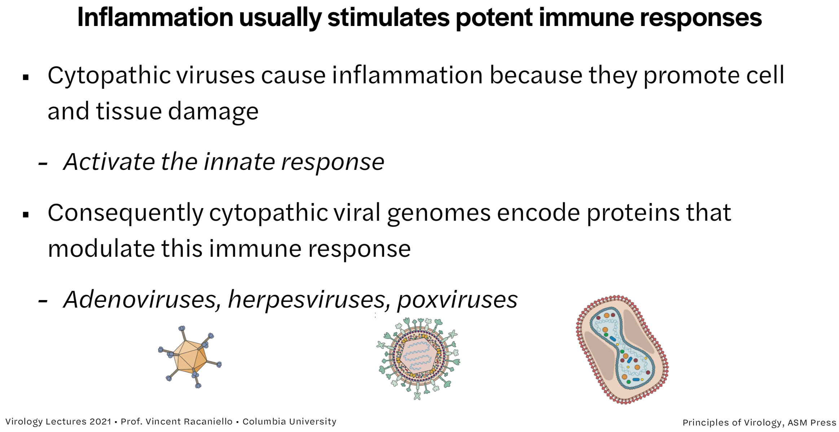
Modeling the Pandemic - Virology for dummies: What you need to know about viruses to model epidemics

Slide 24
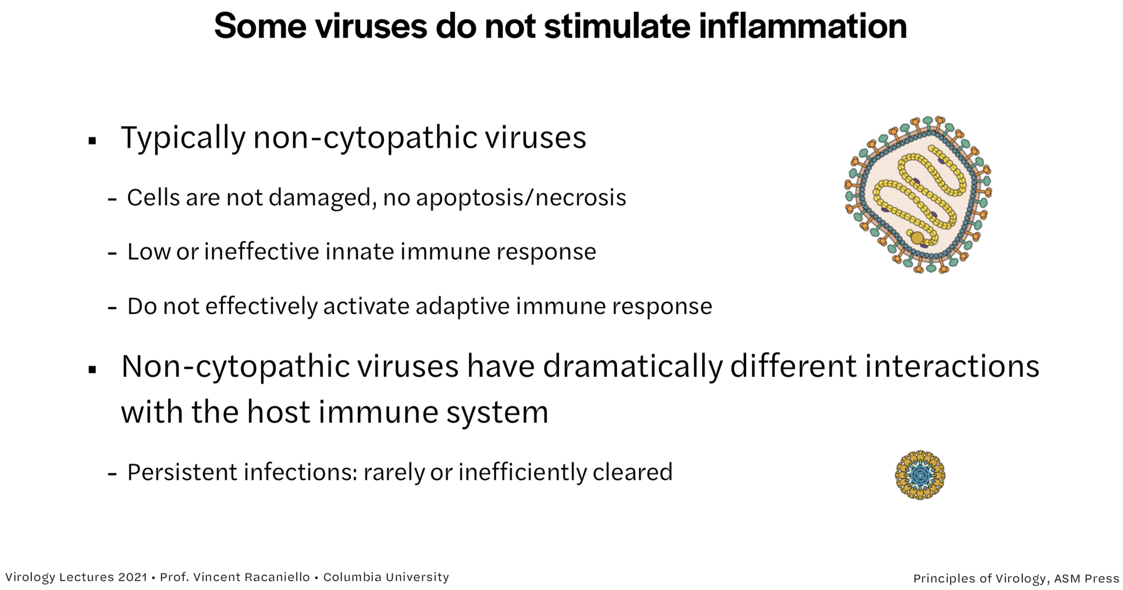
Modeling the Pandemic - Virology for dummies: What you need to know about viruses to model epidemics

Slide 25
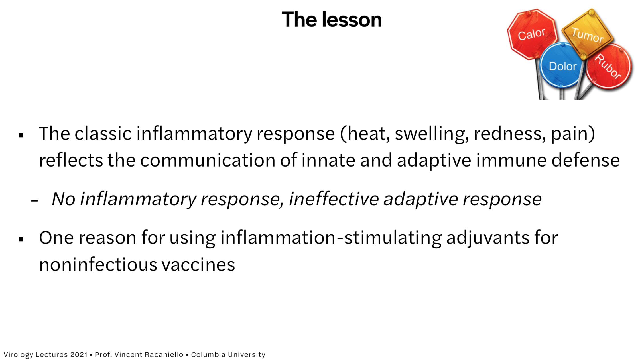
Modeling the Pandemic - Virology for dummies: What you need to know about viruses to model epidemics

Slide 26
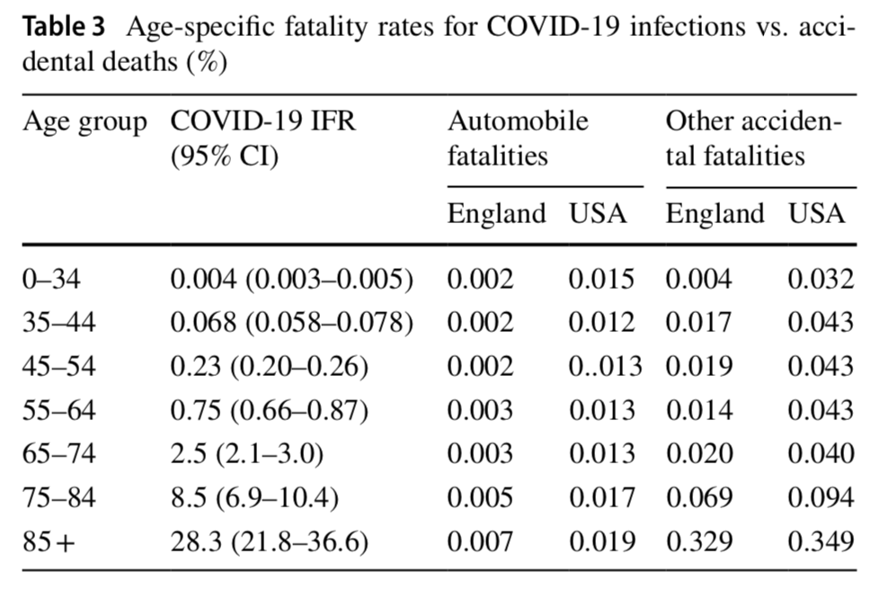
Modeling the Pandemic - Virology for dummies: What you need to know about viruses to model epidemics
Sometimes it doesn’t work well enough…

Slide 27
Assessing the age specificity of infection fatality rates for COVID‐19: systematic review, meta‐analysis, and public policy implications
Resources to go further
Vincent Racaniello’s virology course (https://www.virology.ws/course/)
Chris R. Triggle et al., "A Comprehensive Review of Viral Characteristics, Transmission, Pathophysiology, Immune Response, and Management of SARS-CoV-2 and COVID-19 as a Basis for Controlling the Pandemic", Frontiers in Immunology, 2021
Andrew T. Levine et al., "Assessing the age specificity of infection fatality rates for COVID-19: systematic review, meta-analysis, and public policy implications", European Journal of Epidemiology, 2020

